Slide 1


Early YearS... Where the magic happens
Our Early Years provision is Outstanding. Inspectors praised:
A nurturing and stimulating environment where children feel happy and safe.
Highly skilled staff who tailor learning to each child’s needs and use effective questioning to develop vocabulary and communication.
A rich, well-structured curriculum that helps children achieve exceptionally well across all areas of learning.
Strong relationships between staff and families, ensuring children settle quickly and thrive.
Foundations of learning and growth in early education
Notes:
AI-generated content may be incorrect. ---

Slide 2
Early Years Overview
Notes:
--- This slide references information from the following file: https://cumbriaeducationtrust-my.sharepoint.com/personal/jhelliwell_castlecarrock_cumbria_sch_uk/_layouts/15/Doc.aspx?sourcedoc=%7BAD297396-6A1E-46DE-8A9A-C40427453A5C%7D&file=English%20at%20Castle%20Carrock%20School.pptx&action=edit&mobileredirect=true Welcome & Vision, Acorns Class (Ages 3–5), Staffing, Uniform & Essentials, The School Day, Learning Environment, Curriculum & Approach, Parental Involvement, Preparing for School, Behaviour & Welfare

Slide 3
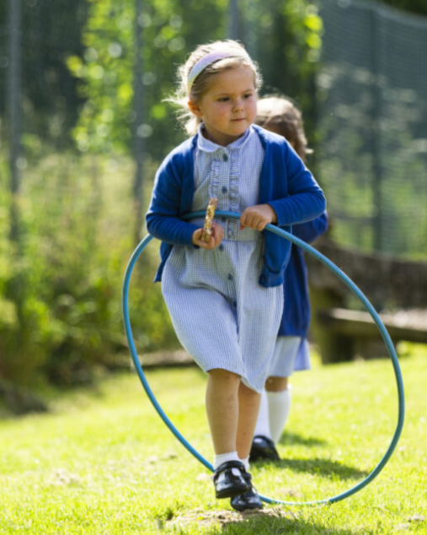
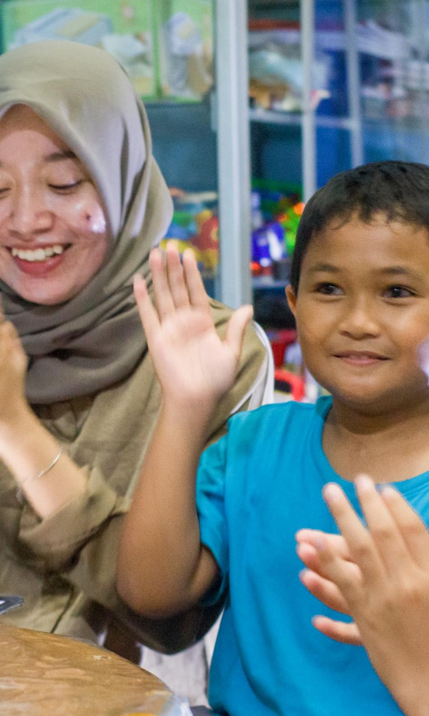
We AIM to provide..
A nurturing learning environment
Creating a stimulating and supportive space where children feel excited and valued every day.
Individualised support
Recognising each child’s unique needs and starting points to ensure personalised progress.
Home-School collaboration
Strong partnerships with parents and carers to build a supportive community for each child's growth.
Foundations for lifelong learning
Fostering emotional and academic growth to prepare children for continued success in life.
Notes:
--- This slide references information from the following file: https://cumbriaeducationtrust-my.sharepoint.com/personal/jhelliwell_castlecarrock_cumbria_sch_uk/_layouts/15/Doc.aspx?sourcedoc=%7BAD297396-6A1E-46DE-8A9A-C40427453A5C%7D&file=English%20at%20Castle%20Carrock%20School.pptx&action=edit&mobileredirect=true At Castle Carrock School, the Early Years Foundation Stage (EYFS) is where the magic truly begins. We strive to create a nurturing, stimulating, and enabling environment that excites children to come to school each day and supports them in making the best possible progress. Our approach is rooted in understanding that each child is unique, with different starting points and individual needs. Teachers are committed to fostering a space where children feel valued and supported. We also recognise the vital role that parents, carers, and the wider family play in shaping young lives. Strong home-school links are essential to help children feel settled and part of the Castle Carrock family. This collaborative ethos ensures that children thrive both emotionally and academically, laying a strong foundation for lifelong learning.

Slide 4
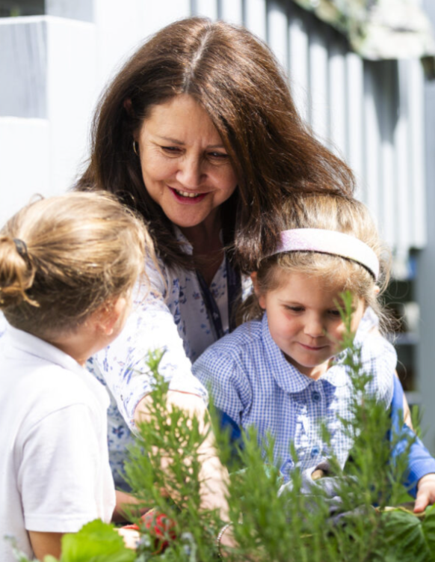
Acorns Class 1 (Ages 3–5)
Age Group and Class Structure
Acorns Class serves children aged 3 to 5, covering both Nursery and Reception early education years.
School Hours and Attendance
Reception children attend full-time school from 8.55am to 3.30pm, Monday to Friday, with monitored attendance.
Nursery Sessions and Funding
Nursery offers 15 free hours per week with options for part-time or full-time, plus additional government-funded hours.
Extended Care Options
Breakfast and After School Clubs provide extended childcare for Nursery children for a small fee.
Notes:
--- This slide references information from the following file: https://cumbriaeducationtrust-my.sharepoint.com/personal/jhelliwell_castlecarrock_cumbria_sch_uk/_layouts/15/Doc.aspx?sourcedoc=%7BAD297396-6A1E-46DE-8A9A-C40427453A5C%7D&file=English%20at%20Castle%20Carrock%20School.pptx&action=edit&mobileredirect=true Acorns Class caters to children aged 3 to 5, encompassing both Nursery and Reception years. Full-time education begins at the start of the academic year in which a child turns five, with Reception children attending school five days a week from 8.55am to 3.30pm. Attendance is closely monitored once children reach compulsory school age. Nursery provision is available during term time for children from the age of three, offering 15 hours of free childcare from the term after their third birthday. Sessions include morning, lunchtime, and afternoon slots, with flexibility for part-time or full-time attendance based on availability. Working parents may qualify for an additional 15 hours under the government’s 30-hour scheme. Taster sessions are also available, and additional hours before funding begins are charged at £3 per hour. Nursery children can attend Breakfast Club and After School Club for a small fee, providing extended care options for families.

Slide 5
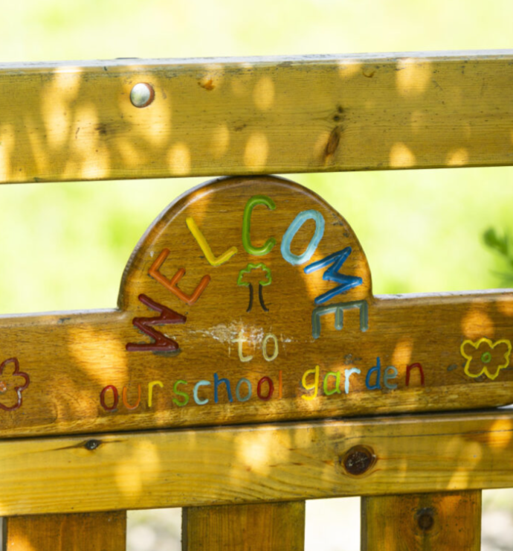

Staffing
Experienced Leadership
Jane Helliwell leads the team with over ten years of experience in Early Years education.
Dedicated Support Staff
Julie Docherty brings 20+ years as a Nursery Nurse and teaching assistant to support the team.
Child-Centered Approach
Staff focus on nurturing children’s potential through a caring, consistent and stimulating learning environment which is tailored to meet the needs of each child.
Notes:
--- This slide references information from the following file: https://cumbriaeducationtrust-my.sharepoint.com/personal/jhelliwell_castlecarrock_cumbria_sch_uk/_layouts/15/Doc.aspx?sourcedoc=%7BAD297396-6A1E-46DE-8A9A-C40427453A5C%7D&file=English%20at%20Castle%20Carrock%20School.pptx&action=edit&mobileredirect=true The Early Years team at Castle Carrock School is led by Jane Helliwell, who has over a decade of experience across all key stages and specialises in Early Years provision. Supporting her is Julie Docherty, a highly experienced Nursery Nurse and higher-level teaching assistant who has been with the school for more than 20 years. Their combined expertise ensures a high-quality, consistent, and caring environment for all children in the EYFS setting. The staff’s deep understanding of child development and commitment to nurturing each child’s potential plays a crucial role in the success of the Early Years programme.

Slide 6
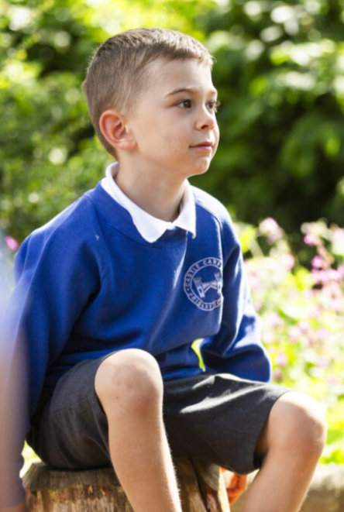

Uniform & Essentials
Wearing a school uniform is an essential part of being a pupil at Castle Carrock and we encourage our children, including Nursery children, to wear their uniform with pride, reflecting the school values of respect, responsibility and the ethos of being the ‘best you can be.’
Full details of uniform requirements and how to order items can be found on our school website, as well as information on how to apply for a school clothing grant for those who may be eligible.
There are also details about what your child will need to wear for PE lessons which are held twice a week. PE kits must be kept in school and will be sent home at the end of each half term to be washed. All items must be clearly labelled with your child’s name.
In Early Years, we also ask parents to send in a pair of Wellington boots (to be kept in school) for all children so that we can make the most of the outdoors whatever the weather.
Children should come to school with an outdoor coat appropriate to the weather conditions, with hats and gloves in winter, and a sun hat/baseball cap and with suncream applied at home in the spring/summer months. Additionally, as children within Nursery and Reception may have an accident from time to time, we ask that a set of spare clothes and underwear are added to their PE bags. Shoes should be easy to change independently, with black Velcro fastenings often the best.
Notes:
--- This slide references information from the following file: https://cumbriaeducationtrust-my.sharepoint.com/personal/jhelliwell_castlecarrock_cumbria_sch_uk/_layouts/15/Doc.aspx?sourcedoc=%7BAD297396-6A1E-46DE-8A9A-C40427453A5C%7D&file=English%20at%20Castle%20Carrock%20School.pptx&action=edit&mobileredirect=true Wearing a school uniform is an important part of being a pupil at Castle Carrock School, including for Nursery children. It reflects the school’s values of respect, responsibility, and striving to be the best one can be. Full details of uniform requirements, including how to order items and apply for a clothing grant, are available on the school website. Children participate in PE lessons twice a week, and PE kits must be kept in school and clearly labelled. Parents are also asked to provide Wellington boots for outdoor activities, as well as appropriate seasonal clothing such as coats, hats, gloves, and sun hats. Suncream should be applied at home during warmer months. Additionally, a spare set of clothes and underwear should be included in the child’s PE bag to accommodate any accidents. Shoes should be easy for children to change independently, with black Velcro fastenings being ideal.

Slide 7
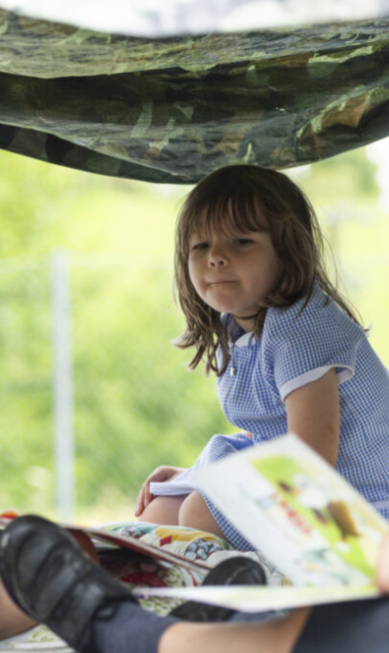

The School Day
Morning Arrival Routine
Staff greet children at the gate from 8:50am, and the school day starts officially at 8:55am with registration at 9am.
Fostering Independence
Children are encouraged to carry their own belongings to promote independence and responsibility.
Safe Collection Procedures
Parents wait outside the gate for safe collection; any changes or delays are communicated with the school office.
Bus Buddy System
Younger children using the bus are paired with older 'bus buddies' to provide support and ensure safety.
Notes:
--- This slide references information from the following file: https://cumbriaeducationtrust-my.sharepoint.com/personal/jhelliwell_castlecarrock_cumbria_sch_uk/_layouts/15/Doc.aspx?sourcedoc=%7BAD297396-6A1E-46DE-8A9A-C40427453A5C%7D&file=English%20at%20Castle%20Carrock%20School.pptx&action=edit&mobileredirect=true Establishing clear routines is essential for providing stability and security for young children. At Castle Carrock School, staff greet children at the school gate from 8.50am, with the school day officially starting at 8.55am. Children line up and enter for registration at 9am. Parents are encouraged to foster independence by allowing children to carry their own belongings. At the end of the day, parents wait outside the school gate to ensure safe collection. Any changes or delays should be communicated to the school office. For children using the school bus, a ‘bus buddy’ system is in place, typically pairing younger children with older ones for support. These routines help children feel secure and ready to learn, while also ensuring their safety and well-being.

Slide 8
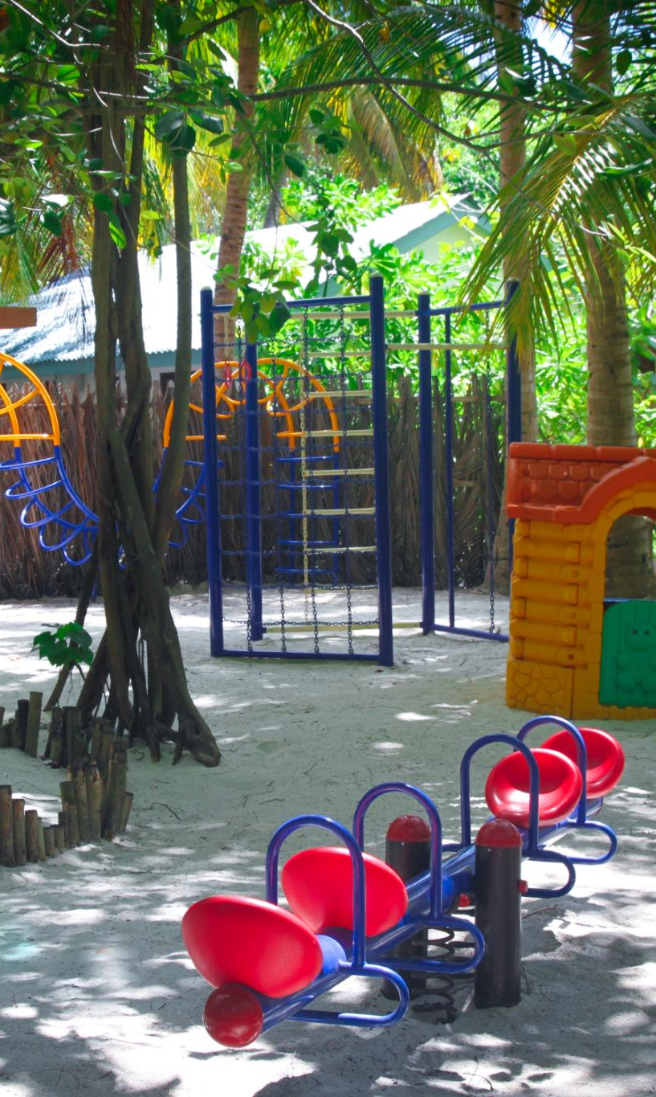
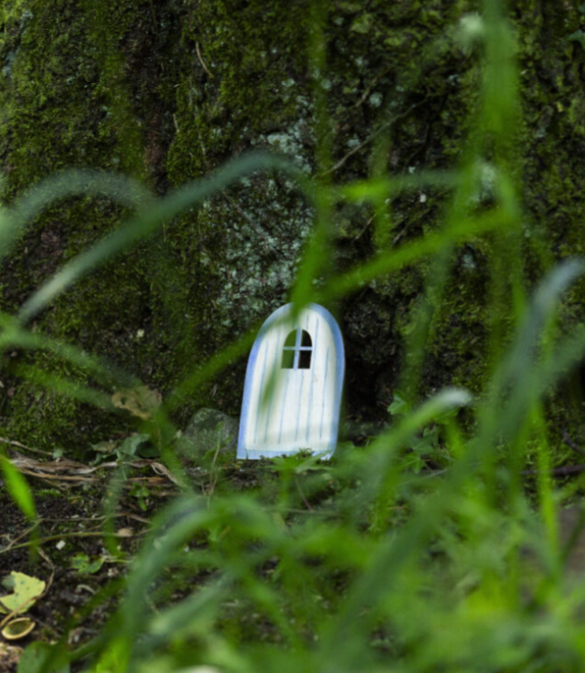
Learning Environment
We have a flexible learning approach. This means our EYFS curriculum adapts to each child's unique needs and interests through play and exploration indoors and outdoors.
We provide high quality resources. Our environment is well-resourced and includes sand and water play, painting, crafting, a science table, a reading corner and role play areas- all of which support child-initiated play. We also have a well-resourced outdoor area which is used for learning opportunities all year round.
Balanced teaching sessions. We tailor teaching for Nursery and Reception groups with whole class daily sesisons in phonics, maths and English. Alongside this we offer continuous provision and topic specific enhancements to deepen our children’s learning.
Holistic child development. We consider each child in the round and focus on the seven learning areas of literacy, communication, maths, physical development, emotional development, understanding world, and expressive arts.
Notes:
--- This slide references information from the following file: https://cumbriaeducationtrust-my.sharepoint.com/personal/jhelliwell_castlecarrock_cumbria_sch_uk/_layouts/15/Doc.aspx?sourcedoc=%7BAD297396-6A1E-46DE-8A9A-C40427453A5C%7D&file=English%20at%20Castle%20Carrock%20School.pptx&action=edit&mobileredirect=true The Early Years curriculum at Castle Carrock School is designed to be flexible and responsive to each child’s unique needs and interests. Learning occurs through play, exploration, and creative thinking, both indoors and outdoors. The environment is rich with resources that support structured teaching and child-initiated play. Daily access to continuous provision includes sand and water play, small world areas, painting, crafting, science investigations, writing and reading zones, and role play. Enhancements are added to reflect current topics. Children participate in whole-class carpet sessions for phonics, maths, and English, followed by more tailored teaching for Nursery and Reception groups. This balanced approach fosters holistic development across the seven areas of learning: literacy, communication and language, maths, physical development, personal, social and emotional development, understanding the world, and expressive arts and design.

Slide 9
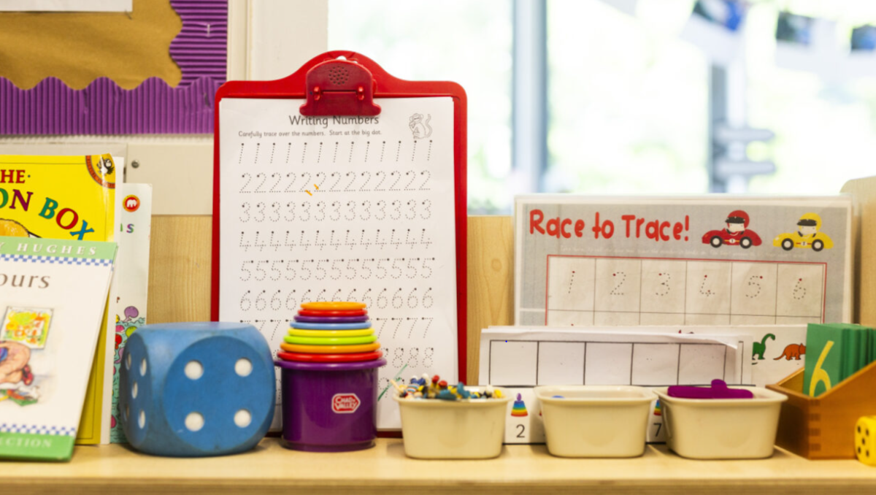
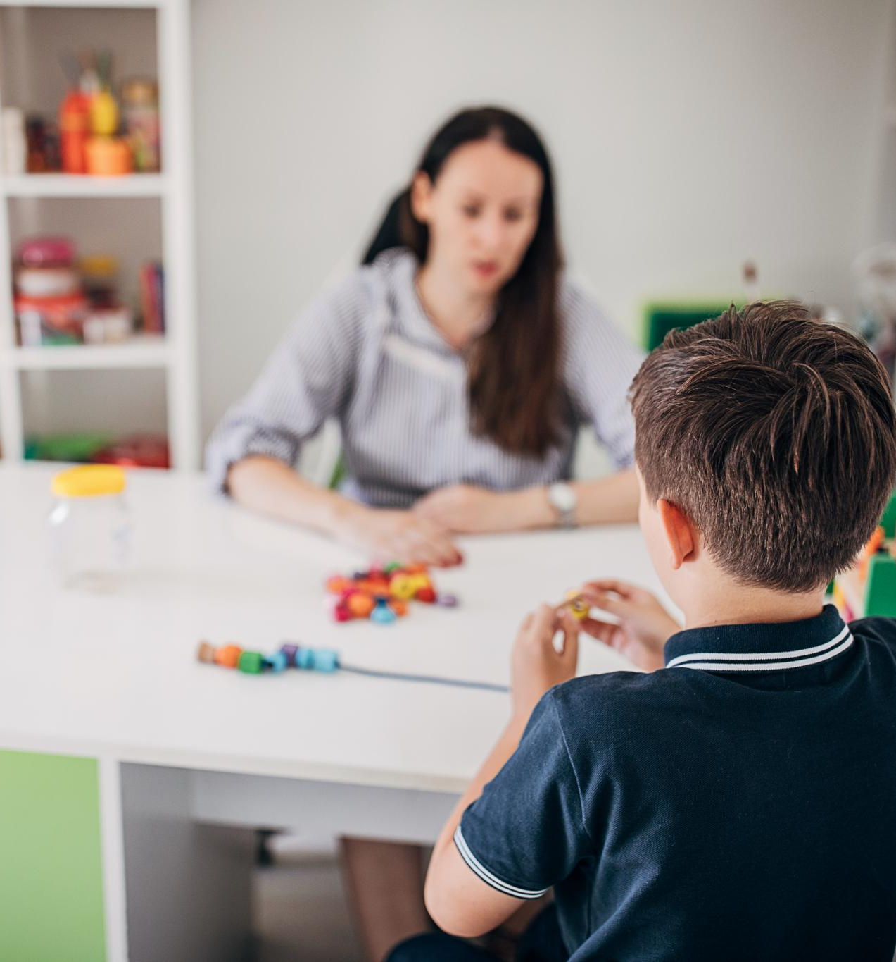
Curriculum & Approach
Play-Based Curriculum
The school uses a play-based Early Years curriculum rooted in Development Matters principles to spark curiosity and love of learning.
Promoting Independence
The curriculum promotes independence, resourcefulness and resilience, encouraging children to think critically and freely.
Continuous Review and Assessment
Regular review and assessment ensure high standards are maintained, preparing confident and capable learners for the future.
Notes:
--- This slide references information from the following file: https://cumbriaeducationtrust-my.sharepoint.com/personal/jhelliwell_castlecarrock_cumbria_sch_uk/_layouts/15/Doc.aspx?sourcedoc=%7BAD297396-6A1E-46DE-8A9A-C40427453A5C%7D&file=English%20at%20Castle%20Carrock%20School.pptx&action=edit&mobileredirect=true Castle Carrock School follows a play-based Early Years curriculum grounded in the principles outlined in the Development Matters document. The curriculum is broad, balanced, and tailored to the unique context of the school’s catchment area. It aims to spark curiosity, broaden horizons, and instill a love of learning. The Early Years team is dedicated to promoting independence, resourcefulness, and resilience. Children are encouraged to think freely and critically about the world around them. Regular review and assessment of practice ensure that high standards are maintained. This approach supports the development of confident, capable learners who are well-prepared for future educational experiences.

Slide 10
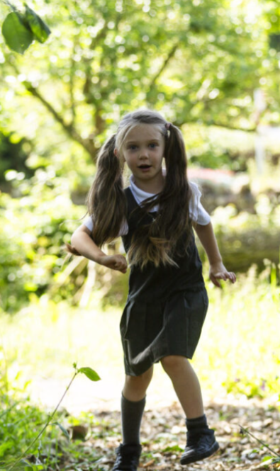


Parental Involvement
The school follows an open-door communication policy.
In Early Years, each child’s learning journey is shared through the online platform Tapestry.
Parents’ evening takes place twice yearly and a school report goes home at the end of each year.
The school weekly newsletter keeps parents informed of what has happened in school and what is coming up.
Parents also invited to celebration assemblies each month.
Parents are encouraged to support reading at home and attend workshops to enhance learning.
Notes:
--- This slide references information from the following file: https://cumbriaeducationtrust-my.sharepoint.com/personal/jhelliwell_castlecarrock_cumbria_sch_uk/_layouts/15/Doc.aspx?sourcedoc=%7BAD297396-6A1E-46DE-8A9A-C40427453A5C%7D&file=English%20at%20Castle%20Carrock%20School.pptx&action=edit&mobileredirect=true Parental involvement is highly valued at Castle Carrock School. The school operates an open-door policy, encouraging parents to discuss any aspect of their child’s development. Observations are recorded using the Tapestry online learning journal, which parents can access and contribute to. Formal parents’ evenings are held in the Autumn and Spring terms, and a written report is provided at the end of the academic year. Weekly newsletters keep families informed about school activities and upcoming events. Parents are invited to monthly celebration assemblies and can participate in PTA-organised fundraising events. Reading at home is strongly encouraged, with Reception children bringing home books and library selections each week. Parent workshops and meetings are held throughout the year to support learning at home and strengthen the school community.

Slide 11
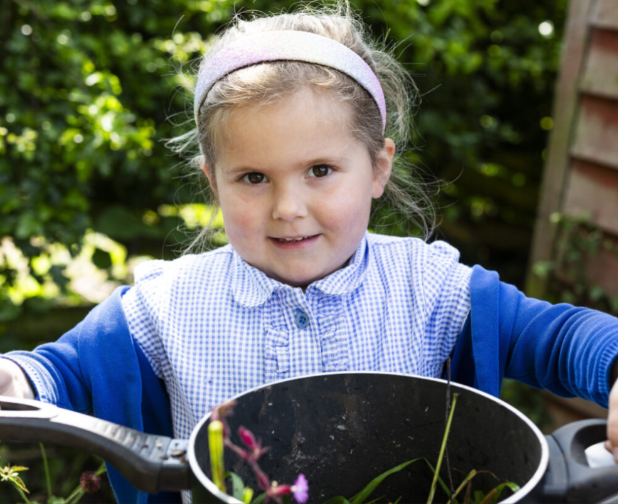
Preparing for School
Developing independence skills -
Encourage your child to learn to dress independently and manage self-care routines like handwashing and toilet training.
Early literacy activities - Play take turn-taking games. Share books with your child. Listen for sounds in the environment. Encourage mark-making at every opportunity. Share nursery rhymes
Numeracy – Sing number-based nursery rhymes, practice counting by rote. Spot numbers in the environment. Play games likes snakes and ladders. Teach children to recognize numbers on a dice.
Notes:
--- This slide references information from the following file: https://cumbriaeducationtrust-my.sharepoint.com/personal/jhelliwell_castlecarrock_cumbria_sch_uk/_layouts/15/Doc.aspx?sourcedoc=%7BAD297396-6A1E-46DE-8A9A-C40427453A5C%7D&file=English%20at%20Castle%20Carrock%20School.pptx&action=edit&mobileredirect=true Preparing children for school involves developing key independence skills. Parents are encouraged to help their child practice dressing independently, including managing buttons, zips, and shoes. Toilet training, handwashing, and basic self-care routines are important for building confidence. Children should also learn to cut food with utensils and take responsibility for tidying up. Recognising their name and responding to it consistently is beneficial. Turn-taking games and phonics activities, such as identifying initial sounds and blending words, support early literacy. Rhyming games and watching educational programmes like CBeebies Numberblocks can enhance numeracy skills. These activities help children transition smoothly into the school environment and foster a positive attitude toward learning.

Slide 12
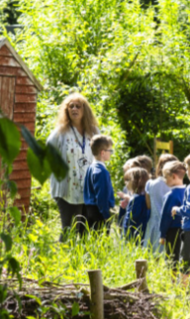
Behaviour & Welfare
Child safety and safeguarding
The school implements rigorous safeguarding procedures to prioritise children’s safety and well-being at all times.
Positive behaviour management
We have high expectations for behaviour and we use positive reinforcement to encourage good behaviours for learning and kind actions like sharing and caring.
Health care and communication
All staff are paediatric first aid trained; parents are informed of incidents and medication administration is managed carefully.
Support for developmental needs
SEND support is bespoke and monitored carefully. Behaviour management plans are implemented where necessary and children are treated with dignity and respect whenever intimate care is required.
Notes:
--- This slide references information from the following file: https://cumbriaeducationtrust-my.sharepoint.com/personal/jhelliwell_castlecarrock_cumbria_sch_uk/_layouts/15/Doc.aspx?sourcedoc=%7BAD297396-6A1E-46DE-8A9A-C40427453A5C%7D&file=English%20at%20Castle%20Carrock%20School.pptx&action=edit&mobileredirect=true Safeguarding is the top priority at Castle Carrock School. Rigorous procedures are in place to ensure children’s safety and well-being. The school promotes high expectations for behaviour, focusing on positive reinforcement and encouraging responsible actions like sharing and caring. Behaviour management is tailored to each child’s developmental stage, and concerns are addressed in partnership with parents. All staff are paediatric first aid trained, ensuring prompt care in case of accidents or illness. Parents are informed of any incidents, and prescribed medication can be administered during school hours. Absences due to illness should be reported to the school office. Toilet training is supported in line with Ofsted guidelines, and intimate care is provided with dignity and respect. This comprehensive approach ensures a safe, supportive environment where children can thrive.

