Slide 1
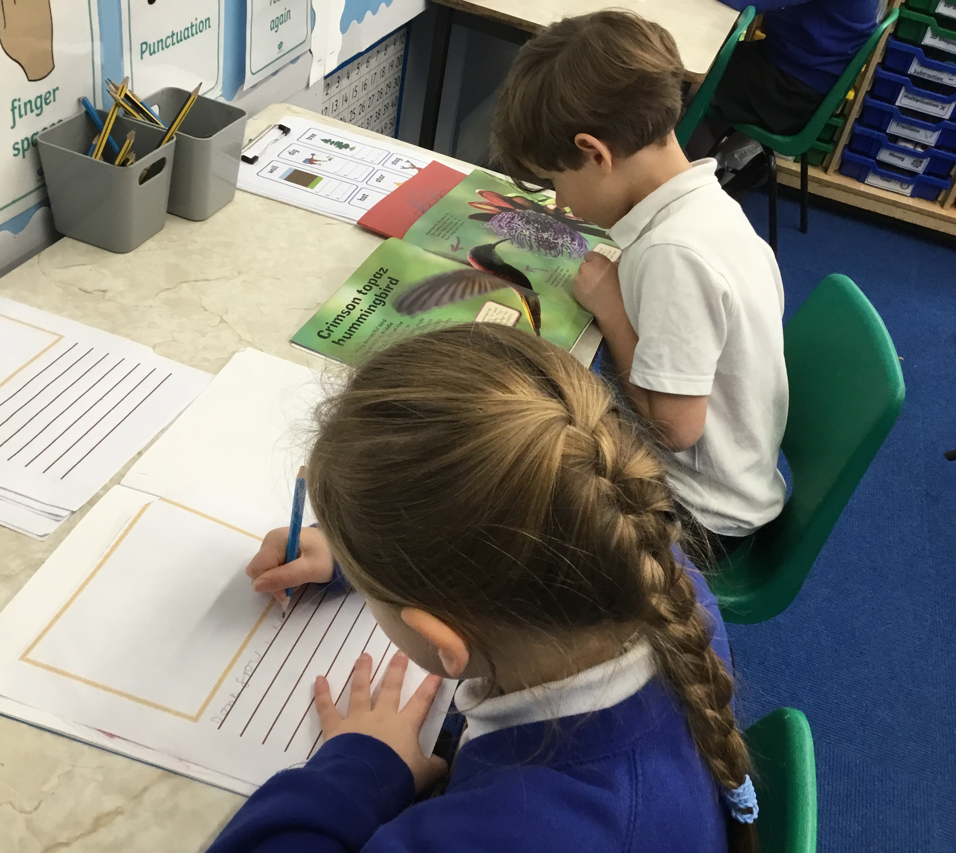
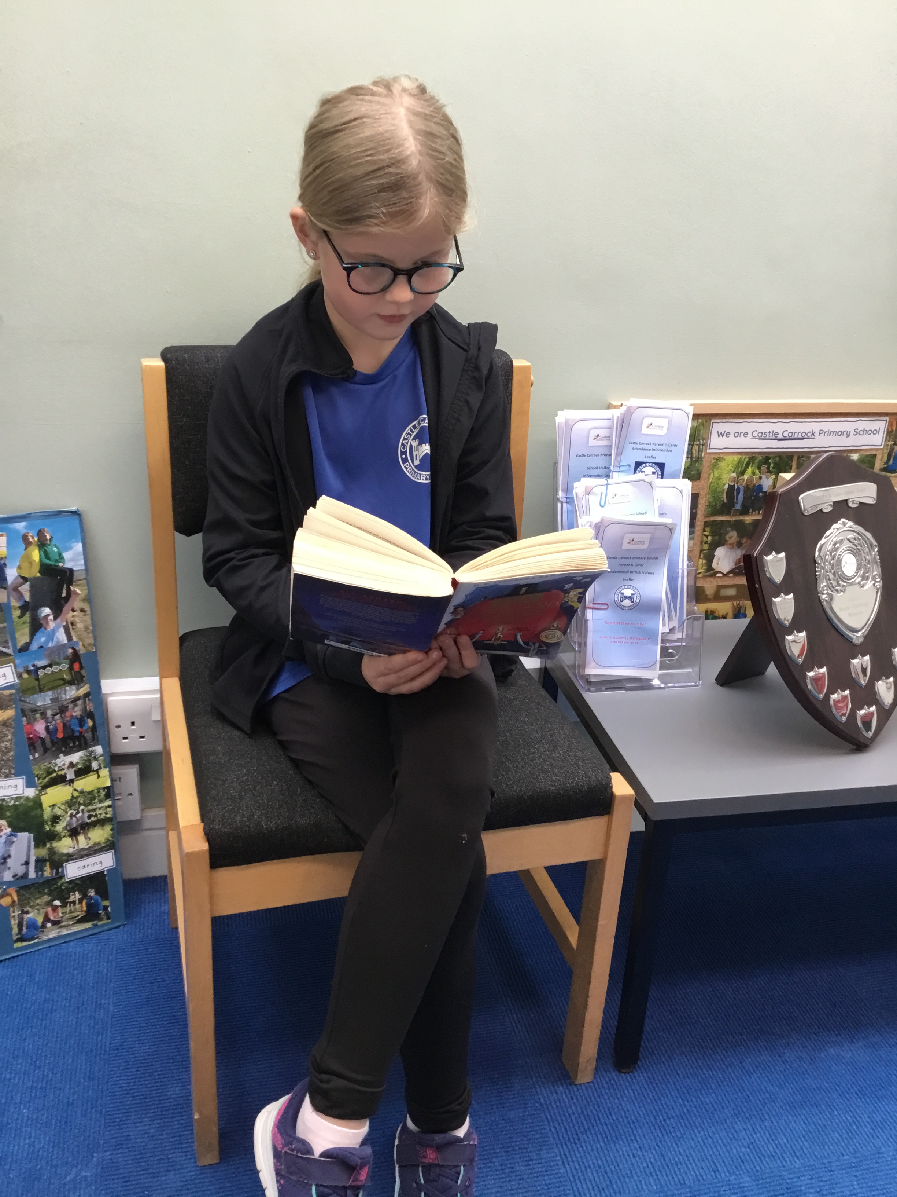




=
English
.
k
“I kept always two books in my pocket, one to read, one to write in.” Robert Louis Stevenson

Slide 2


Our Mission
Reading and writing are the foundation stones to all areas of learning.
These key skills allow children to become effective communicators and underpin all learning. They help boost memory, improve confidence and are crucial for personal, social and economic success.
When teaching English our aim is to...
Enable our children to become confident, enthusiastic readers and writers, empower our children to have their voices heard through a high quality, purposeful, English curriculum and ignite in them a life-long love of reading.
Reading and writing opens doors to better life and work opportunities.

Slide 3




Our mixed-age English curriculum
.
Early Years
Phonics and spelling
Reading comprehension
Reading for pleasure
Cultural and literary awareness
Speaking and listening
Writing
Vocabulary development
Grammar and language awareness
Spelling and Handwriting

Slide 4
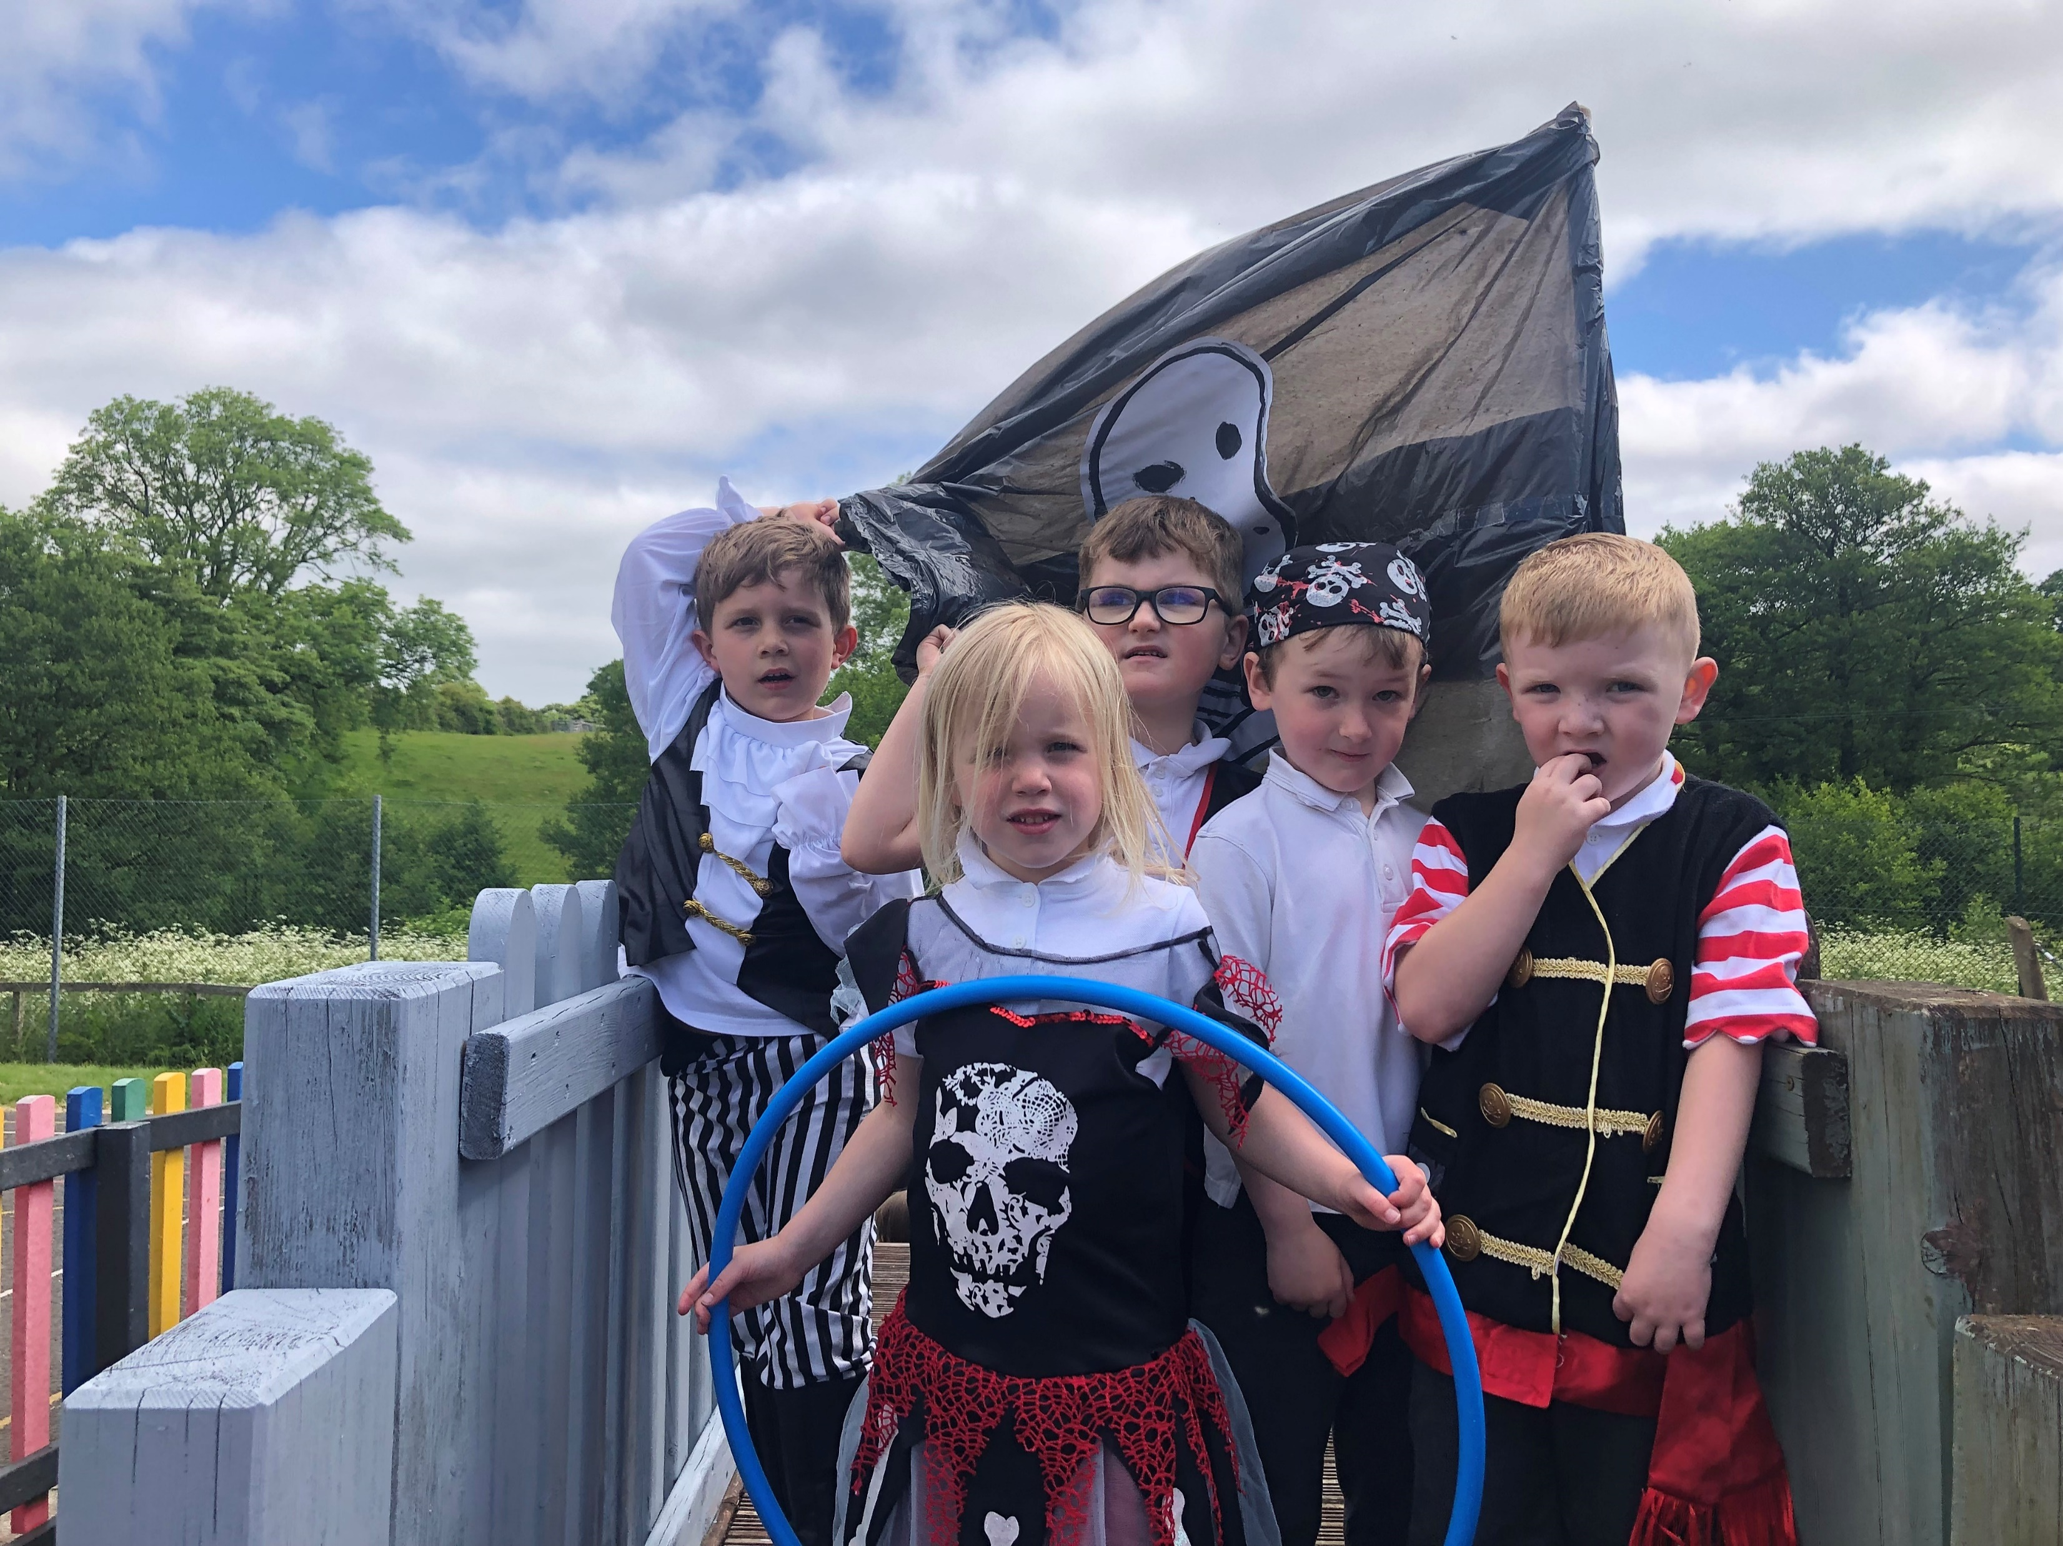
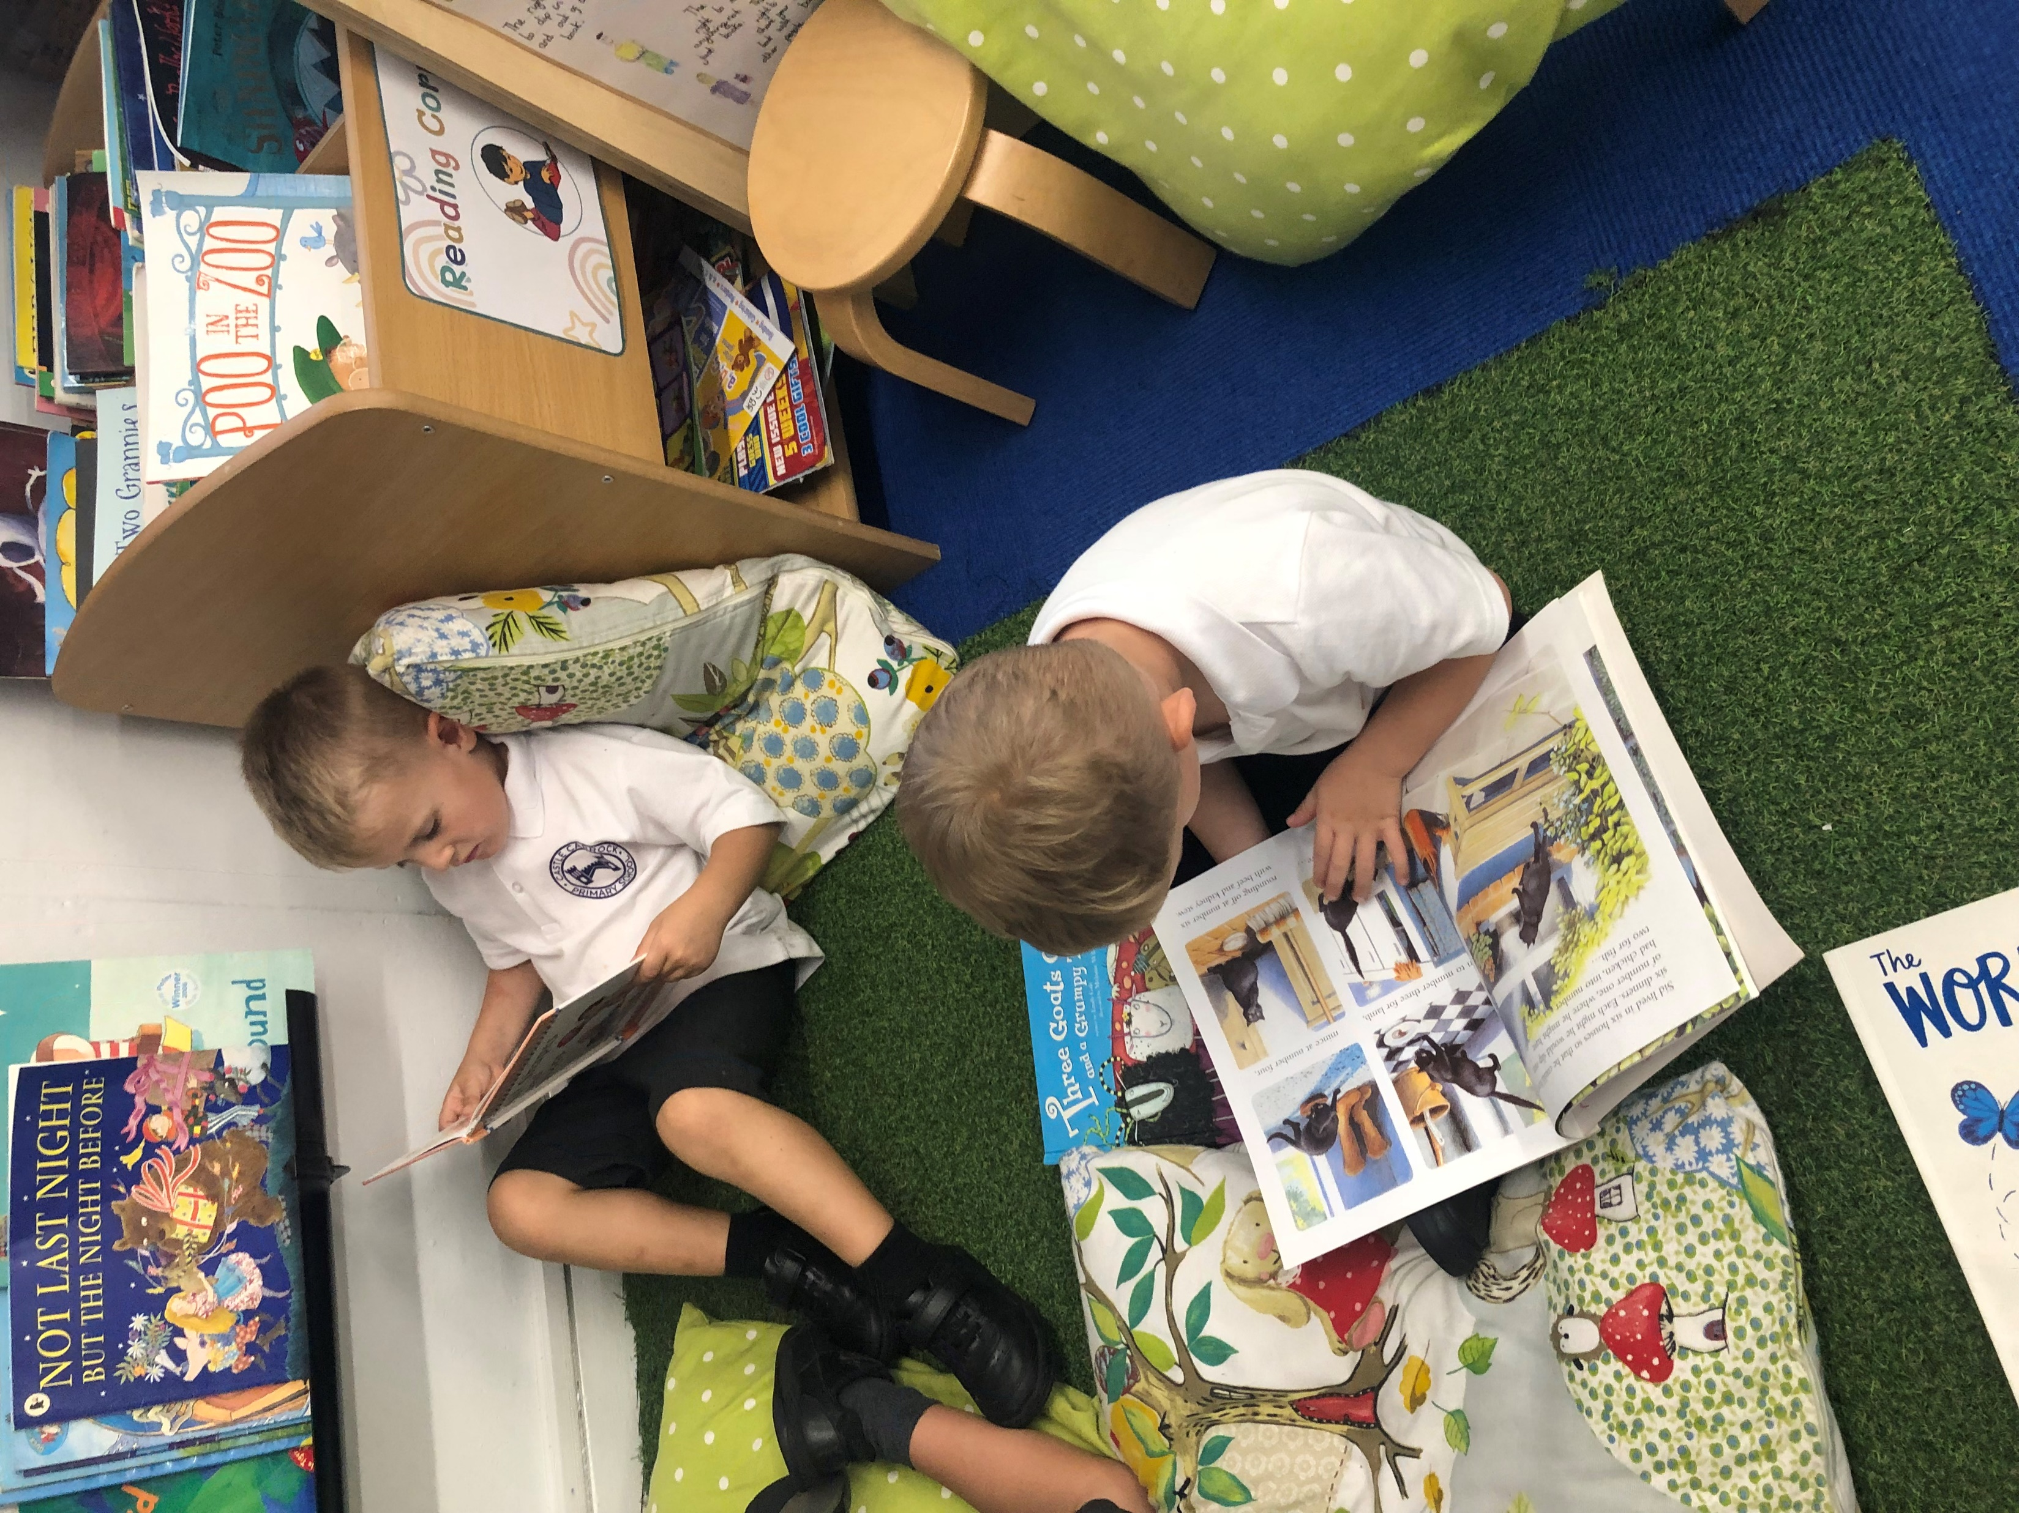
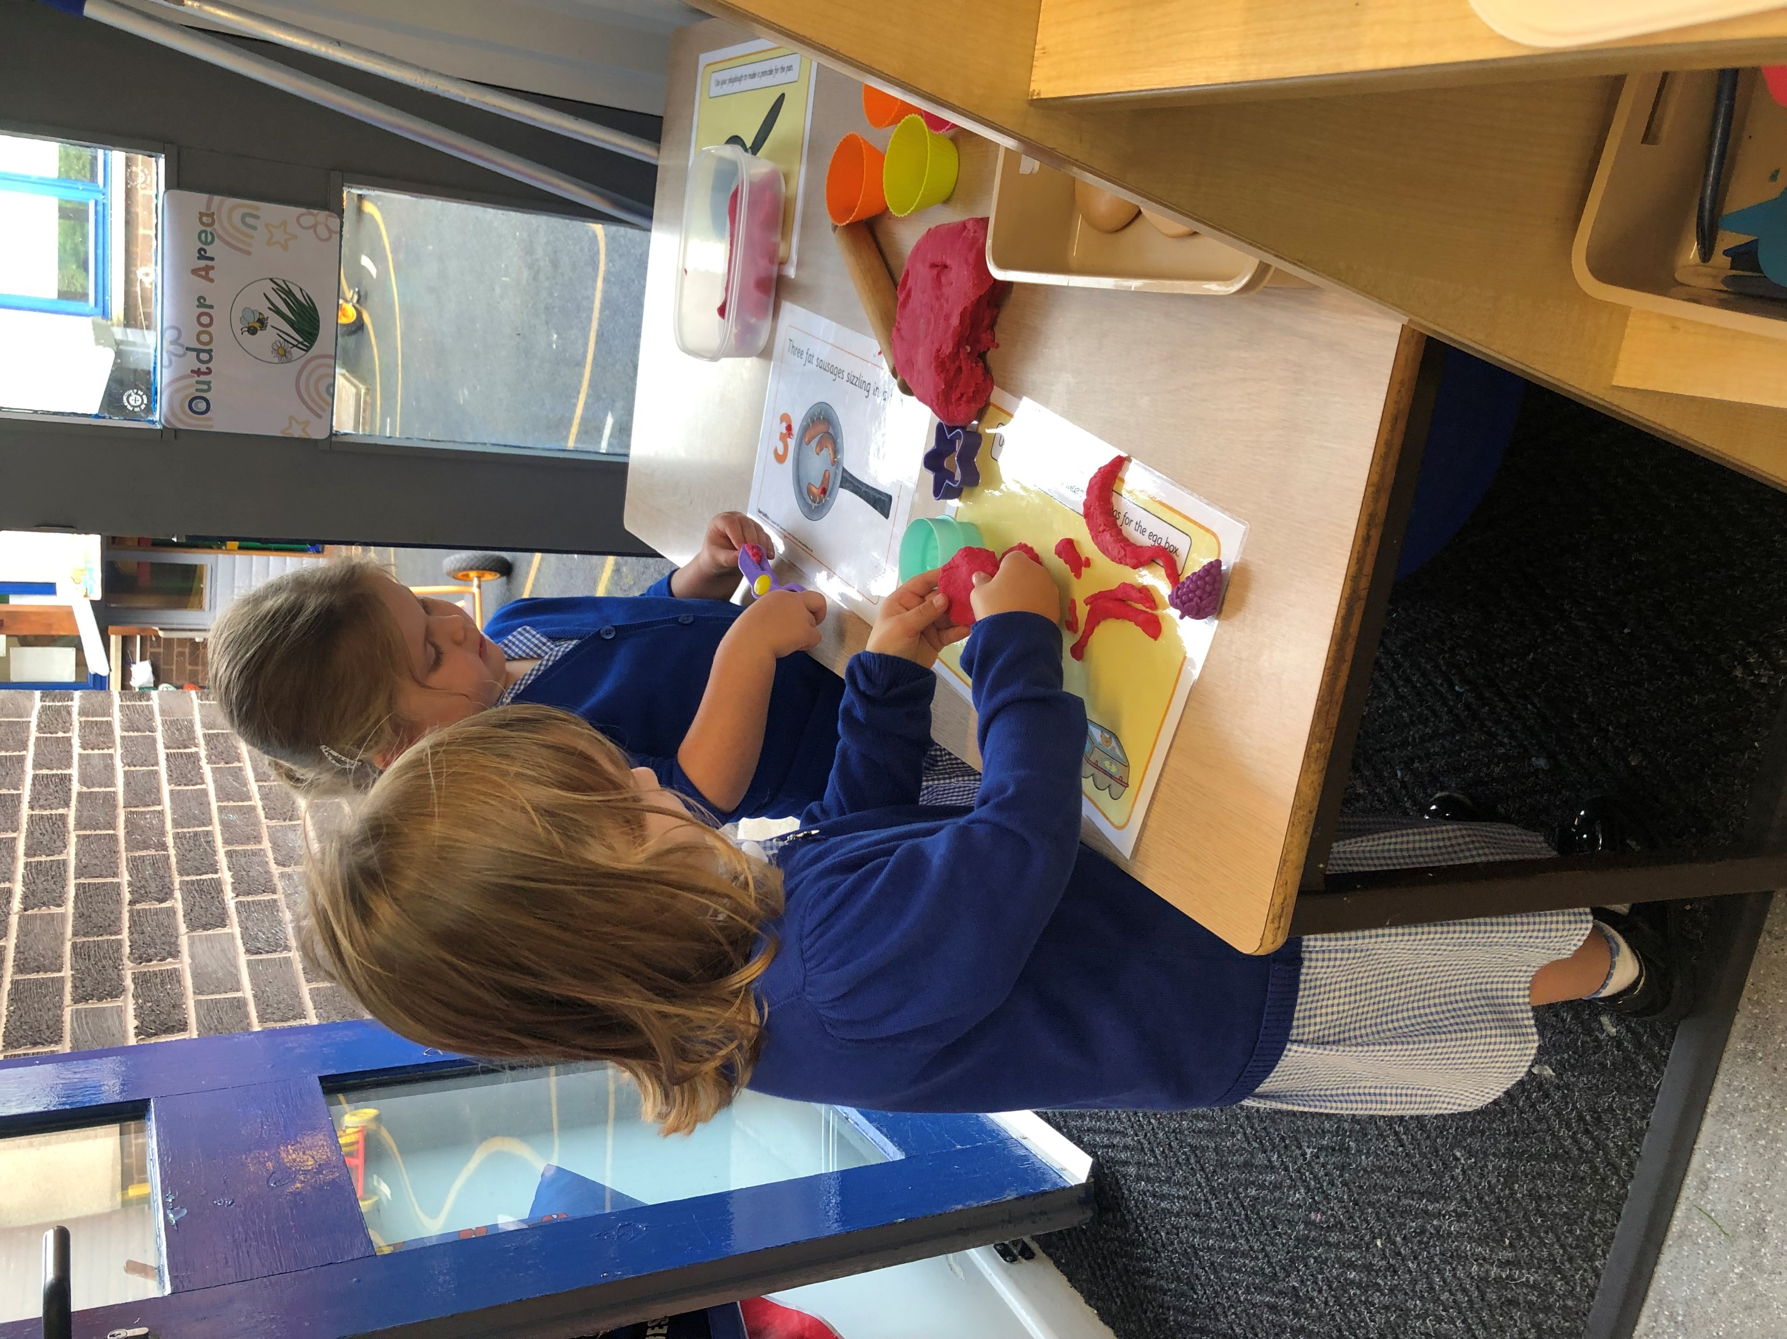
English...in Early Years
O
In Early Years, English is not taught as a formal subject. Instead, it is carefully woven through communication, language and literacy-rich experiences. The focus is on developing the building blocks of reading, writing and spoken language in playful, purposeful ways.
Communication and language
Building strong listening, attention and speaking skills through daily story time, songs, rhymes and conversations. This includes role play and retelling of familiar stories, as well as open-ended questioning, such as ‘What might happen next or why do you think that?’
Reading
Developing a love of books through adults modelling reading for pleasure. Sharing high quality picture books, exposure to sounds, rhymes and oral blending and teaching early reading skills following the DfE accredited Little Wandle phonics scheme.
Writing
Developing fine and gross motor skills through mark making opportunities in every area of provision. Our children are encouraged to thread, use playdough and paint as they strengthen their muscles in readiness for writing.

Slide 5


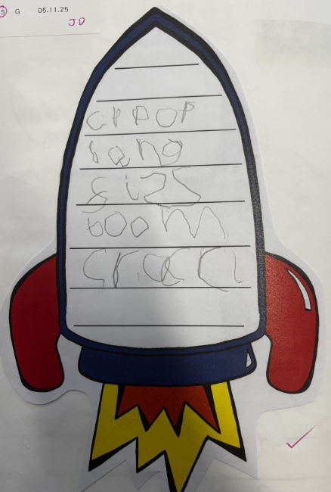
Writing...in Early Years
O
As soon as children begin mark making, we encourage ‘writing’ in Early Years.
Formal letter formation instruction begins in Reception with the children learning how to write graphemes (letters) as they learn the phonemes (sounds).
We teach the children about the importance of good posture, correct pencil grip, paper position and pencil pressure so they learn to write with confidence and control.

Slide 6
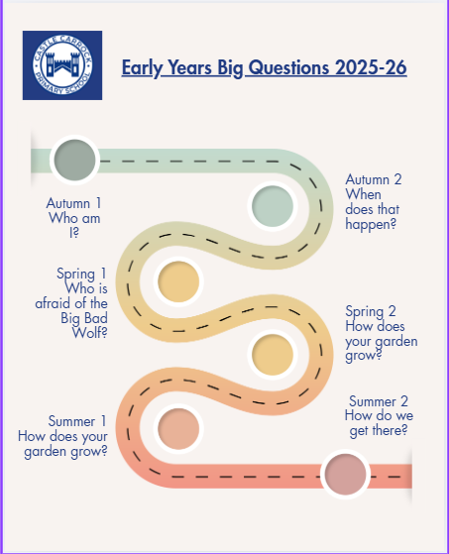
Writing...in Early Years
O
Our topic-based approach to learning focuses on six big questions throughout the year which generates myriad opportunities for those key literacy skills of reading, writing and exploring words.

Slide 7

Phonics and early reading
At Castle Carrock School, reading is taught daily through Little Wandle Letters and Sounds, a systematic, synthetic phonics programme.
It begins in Early Years with Foundation phonics for Nursery children with a focus on listening, oral blending and high-quality stories and rhymes.
In Reception formal phonics teaching begins and grapheme-phoneme correspondences (GPCs) are introduced, along with blending and segmenting simple words, reading and writing simple CVC words.
These rigorous, daily phonics lessons, which incorporate spellings and continue into and throughout Year One, include reading practice sessions 3 times a week using decodable books.
Each half term the children are assessed and reading book levels are matched accordingly. Keep-up sessions are held for children who need them.
At the end of Year One, children sit a statutory Phonics Screening Check. Little Wandle is used in Year Two for those children who need.

Slide 8
Phonics and parental support
We believe supporting children on their learning-to-read journey works best when a partnership is forged between school and home.
Our parents are encouraged to attend phonics session in school to explain how reading is taught and to listen to their child read at home each evening.
The Little Wandle website also has a dedicated ‘For Parents’ section with lots of resources and guides on what the children are learning, how and why.
Much more information about the programme can be viewed by heading to the website.
For parents | Letters and Sounds

Slide 9
Year Two and beyond
When children move into Year Two, the Little Wandle programme focuses on ensuring full consolidation of phonics, before moving into spelling, fluency and broader reading.
As children become fluent decoders, they move from exclusively decodable phonics texts to a wider range of reading materials. Decodable/sound-matched books remain for those who still need reinforcement, with 1:1 support timetabled in.
Whole class daily reading sessions are then delivered to develop important reading comprehension skills. Opportunities for all children to practice reading are maximised daily across the curriculum, with a drive on developing fluency, oracy skills, expanding vocabulary and deepening comprehension.

Slide 10
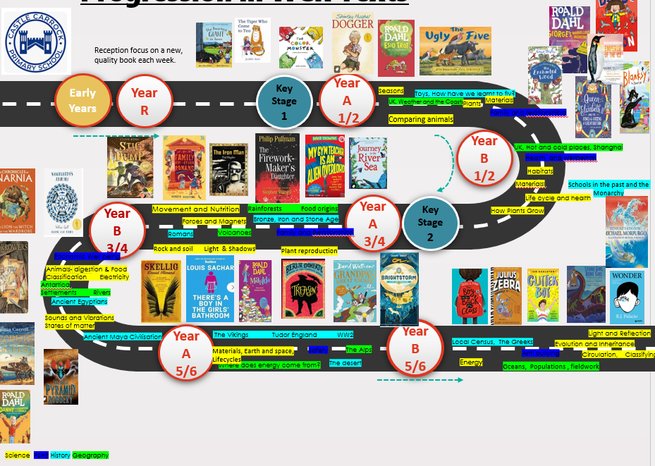
KS2 whole class reading

Slide 11
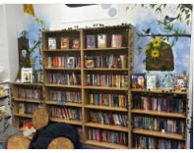

Reading for pleasure
We embrace reading for pleasure at Castle Carrock School and celebrate and promote positive attitudes towards reading in all forms.
We have a lovely library which the children are encouraged to use daily. It is home to a huge range of high-quality picture books, non-fiction books, short chapter books and texts of all genres.
There really is something for everyone and the children can take books home on loan.
We also have regular ‘Mystery Readers’ in school – surprise guests who come in to share books with the children. Children are encouraged to bring favourite books from home to share with their class and to make recommendations and carry out reviews to spread the joy of reading a good book.

Slide 12

Writing
O
Our mixed age writing curriculum uses a text-based approach, supported by the Literacy Company, to help children acquire knowledge of grammatical structures and text types in an engaging and accessible way.
Our pupils are encouraged to enjoy writing. We want them to be able to write independently – showing enthusiasm and resilience in their work.
Our pupils are taught to write for purpose, with an awareness of their audience.
We teach them how to use a wide range of sophisticated vocabulary, spelling and grammar skills and how to edit and evaluate their work to be the best it can be.
The texts we have chosen, which follow a two-year cycle, have been carefully selected on their literary merit. They ensure an appropriate level of challenge and relate to our school values and the wider curriculum for each year group.

Slide 13
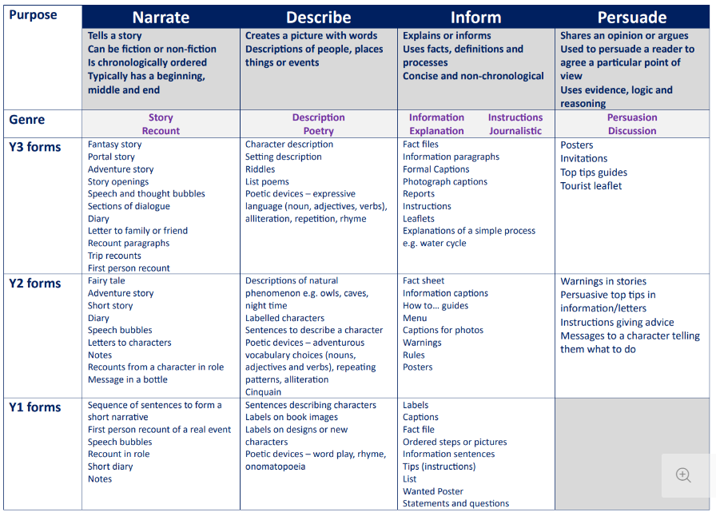
Overview of
Writing Outcomes
O

Slide 14
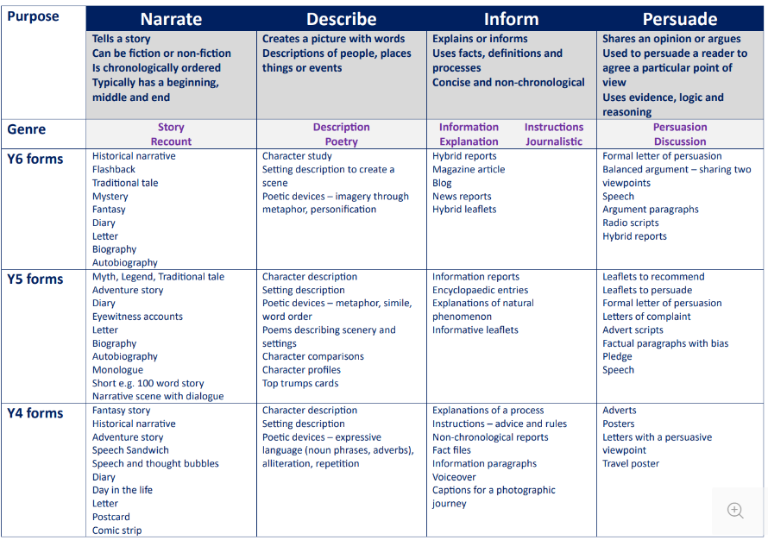
Overview of
Writing Outcomes
O

Slide 15
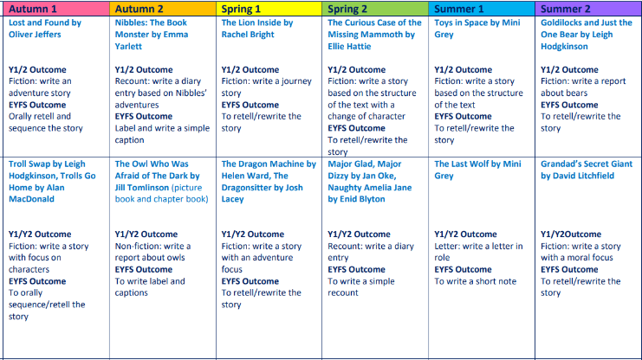
KS1 overview
O

Slide 16
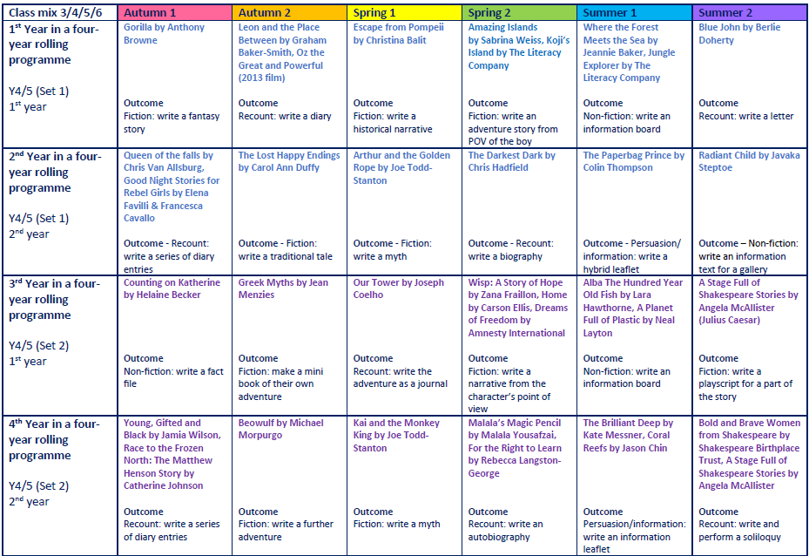
KS2 overview
O

Slide 17


Handwriting
O
At Castle Carrock School we expect high standards of written presentation across all areas of the curriculum. We follow the Oxford University Press Nelson Handwriting scheme to help our children develop clear, legible handwriting in all written work.
Children have discrete handwriting lessons learning correct letter formation, size and spacing and a consistent style is encouraged across all year groups.
As well as learning how to form letters in phonics, Reception children and Year One children have handwriting lessons focusing on the Nelson lowercase letter families.
In Year Two, children move on to developing uppercase letters, joining letters and the formation of simple words.
Years Three to Six consolidate their learning, focusing on joined writing, fluency and presentation.
Differentiation is provided for pupils who require additional support.
We always follow the four Ps
Posture, Pencil grip, Paper position and Pressure

Slide 18


Spellings
O
Our approach to teaching spellings at Castle Carrock school is systematic, cumulative, and tailored to the child’s developmental stage.
Learning how to spell begins in Early Years when children are taught to blend and segment using phonics. They learn how to spell simple words like cat or rain from Phase 2 and 3 of our phonics programme.
In Year One, the expectation is that children become quicker at spelling simple words, and their spellings develop to include new graphemes from Phase 5.
In Year Two, children are taught how to spell words with known digraphs, trigraphs and also words contained common suffixes. For example –ed –ing –s and –es. How to spell tricky words (common exception words) is taught throughout Early Years and KS1.
By Year Three, the children have moved on to spelling more complex vowel patterns, alternative spellings, as well as prefixes/suffixes.
Year Four look at prefixes, suffixes, homophones and complex consonant patterns.
Year Five focus on irregular words, etymology and advanced patterns.
And in Year Six, it’s all about complex morphology, rare patterns and consolidation.
Alongside this, the children have access in school and at home to online spelling games on the Spelling Shed website to help consolidate learning.

