Slide 1




French
Inspiring pupils to develop the skills to listen, speak, read and write in French.

Slide 2
“A different language is a different vision of life.” - Federico Fellini
A high-quality French language education in primary school is important because at this age, children are especially receptive to language learning, and the benefits reach far beyond simply being able to speak some French. These benefits include:
Cognitive Development: learning a second language strengthens thinking skills and improves memory and concentration, together with the ability for problem-solving and reasoning.
Building Early Confidence: by introducing French in a structured, engaging way at KS2, this helps children to practise speaking in front of others, to take safe risks with new vocabulary and sounds and to gain confidence in communication. In turn this reduces anxiety around language learning later in secondary school.
Cultural Awareness and Global Citizenship: a strong KS2 French curriculum helps pupils to understand that people around the world communicate differently and that languages shape cultural identity. The pupils also learn how French language and culture influence food, art, music, science and history.
Laying Foundations for Further Study: a high-quality French programme builds the core skills students will need at KS3 and beyond by incorporating phonics and accurate pronunciation; vocabulary and grammar knowledge; and the ability to listen, speak, read and write in purposeful contexts. With strong foundations, pupils make faster progress in later years and are less likely to disengage.
All children have access to the French curriculum, through adaptive planning and teaching methods, (GDS, SEND/Inclusion) the curriculum is taught creatively which ensures every child will have every opportunity to gain invaluable knowledge of French vocabulary and an awareness of the French culture.

Slide 3
French in our EYFS and KS1 classes
Children learn simple French vocabulary through exposure to songs, familiar stories, counting, greetings and instructions.
Bonjour!
Salut!
Un, deux, trois. Étoile.

Slide 4
French: Key Stage 2
The rolling four-year mixed-age planning programme, which is aligned with the National curriculum, ensures a clear pathway for pupil learning. Progression is broken down into the following key areas:
Phonics – becoming familiar with key French phonemes, spelling and pronunciation.
Vocabulary – introducing commonly-used words; memorising high-frequency keywords.
Grammar – systematically learning French grammar and applying it in a variety of contexts; practising grammar structures in speaking, writing, reading and listening activities.
Language comprehension (listening and reading) – applying knowledge of phonics, vocabulary and grammar; decoding what the children hear and read more accurately and efficiently using a range of strategies.
Language production (speaking and writing) – applying what the children have learnt across other knowledge strands to speak and write in French.
Cultural awareness – learning about French food, celebrations, festivals, art and French-speaking countries around the world.

Slide 5
French in Key Stage 2 2025-26
AUTUMN TERM French Greetings I know that in French there are formal and informal greetings and when it is appropriate to use each one. I know that different greetings are used at different times of the day. I know that tone of voice can indicate a question. I know that a cedilla is the tail mark under the ç and that it changes the pronunciation of the c from a hard sound to a soft ‘s’ sound. I know that French words are pronounced differently to the way they are spelt. French Adjectives I know that a cognate is a word that is the same in both French and English e.g. un triangle. I know that a near-cognate is a word that is very similar but not identical in French and English e.g. un cercle. I know that adjectives of size are positioned in front of the noun in French e.g. un grand cercle. I know that adjectives of colour are positioned after the noun in French e.g. un cercle bleu. | SPRING TERM Playground Games I know that I can use known vocabulary, cognates and near cognates as clues to help me understand a text in French. I know that sentences are often structured differently in French and English. I know the sounds the common phonemes ‘eu’, ‘oi’, ‘ou’ and ‘ui’ make in French. I know the names of some Parisian landmarks. I know some French playground games. In a French Classroom I know that, in French, a space is needed before and after ? and ! I know some of the similarities and differences between school in France and schools in the UK. I know that every French noun is either masculine or feminine. I know that gender affects the form of the word un or une (the indefinite article). I know that when we turn the statement j’ai un/une (I have a…) into a negative je n’ai pas de (I don’t have a…) then we change the article from un/une to de. | SUMMER TERM Bon Appetit I know that feminine nouns often (but not always) end in ‘e’. I know the equivalents for the word ‘the’ in French : le/la/l’/les and ‘a/an/some’ : un, une, des. I know that: Je/j’, and tu and vous are subject pronouns. I know that placing ne…pas around the verb makes it negative: ne + verb + pas. I know some typical French food and/or drink. Shopping for French Food I know how to build 2-digit numbers in words up to 60, using a number builder resource for support if needed. I know how to make good attempts at accurate pronunciation of new vocabulary. I know how a sentence changes according to noun gender. I know how to make predictions about language from a familiar story and join in with an oral performance. I know how to make at least one change to a noun in a given sentence and present the sentence orally.

Slide 6
French in Key Stage 2 2026-27
AUTUMN TERM Portraits: describing in French I know that adjectives change depending on whether they are describing a boy or girl, for example: sérieux and sérieuse. I know how to dentify a person correctly from a description of their hair and eye colour. I know how to place words in the correct order with a sentence, with the adjectives following the noun. I know how to compose a spoken sentence to describe a friend. I know how to write sentences accurately with the correct adjectival agreement, using a support sheet. Clothes: Getting dressed in French I know how to convert the indefinite article to a possessive adjective. I know how to say the words for items of clothing with accurate pronunciation. I know how to write accurately using a support and selecting the correct form of the adjective most of the time. I know how to compose a sentence using j’aime or je n’aime pas. I know how to use il/elle correctly and place the adjective in the correct position in relation to the noun. | SPRING TERM French numbers, calendars and birthdays I know the numbers to 31 in French. I know how to calculate Maths sums correctly in French. I know all the days of the week and months of the year and names of the seasons in French. I know the words for yesterday and today. I know how to ask when someone’s birthday is and give the number and month of my own birthday. I know how to translate the date from English to French. French weather and the water cycle I know a range of weather phrases in French. I know how to intelligibly pronounce sentences to convey the weather in a given place. I know the compass points in French. I know several directions in French I know the correct number for a temperature in French. | SUMMER TERM French Food: Miam, miam ! I know how to complete mathematical calculations in French, writing answers in euros. I know the names of shops in French. I know how to use a bilingual dictionary to translate given words. I know how to ask and respond to questions found in a café conversation. I know how intonation and gesture are used to differentiate between statements and questions. I know how to perform a short French role-play or song. French and the Eurovision Song Contest I know French vocabulary so that I can say where I live. I can write a simple sentence in French to give my opinion about a piece of music. I know the endings of verbs change according to the subject. I know that we can use conjunctions to link phrases, such as et/mais. I know that the verb aimer is used to express an opinion, including with the negative form ne … pas.

Slide 7
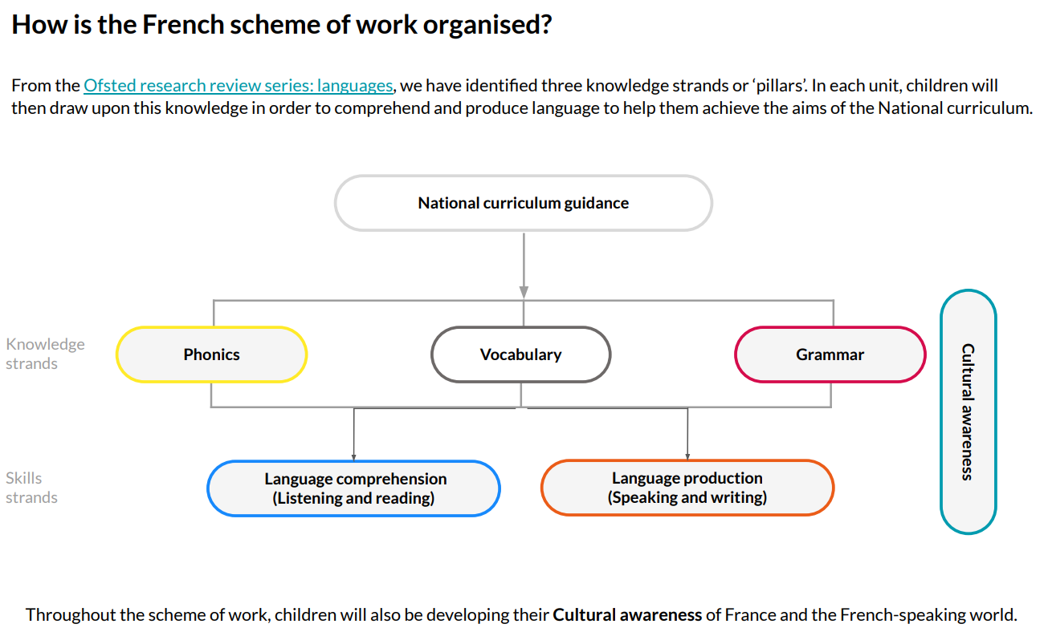

Slide 8
Progression of skills throughout KS2.
Using the knowledge strands, Phonics, Vocabulary and Grammar, the planning cycle aims to provide pupils with a firm foundation of language learning. The teaching sequence will ensure gradual progression and an understanding of the interplay between these elements. The Ofsted research review series: languages refers to these elements as the ‘3 pillars of progression’:
Phonics
A comprehensive French phonics programme has been embedded into the planning, ensuring the explicit teaching of critical phonemes focuses on both pronunciation and the sound-spelling link.
We use short ‘Mouth mechanics’ pupil videos, which native speakers present, to support this learning by including an in-depth look at the shape of the mouth when creating each phoneme.
Vocabulary
The planning systematically introduces the most commonly used words, especially simple and common verbs. It then provides opportunities for students to revisit previously-learned vocabulary in different contexts. This approach allows the children to commit these key words to their long-term memory. Many topic words are also introduced in order to provide a variety of meaningful contexts; however, less attention is given to memorising these. Lessons are designed to ensure that each time new vocabulary is introduced, the pupils have an opportunity to use it in language comprehension and production activities.
Grammar
Grammar is explicitly taught and systematically revisited to ensure that basic structures are committed to memory before more complex ones are introduced. Lessons are organised to allow opportunities to practise grammar structures across modalities (speaking, writing, reading and listening) and carefully scaffolded activities enable children to manipulate the words and grammar themselves and begin to use new language creatively.

